Slide 1
FALL - 2 Advanced Reports and Certification
Fall-2 Overview
2019-20 Changes
Common Problems
Wrap-Up
Notes:
Welcome to the Fall 2 Advanced training for experienced CALPADS users. In this training, we will provide a brief overview of the Fall 2 submission and go over major Fall-2 changes for this year.

Slide 2
Target Audience
Experienced CALPADS
Users
New to CALPADS?
Attend Fall-2 R&C
Notes:
We expect experienced CALPADS data Coordinators to be attending this session.
If you are new to CALPADS, we strongly recommend that you attend the regular Fall-2 Reporting & Certification training as this session's main focus is on the changes only and we would not be discussing the data requirements and population in this session.

Slide 3
Training Sequence
CALPADS Intro
Data Coordinator Orientation
CALPADS
CALPADS Basics
Fall-1 Data Population (Student Profile)
Fall-2 Data Population
EOY 1-4 Data Population
Data Privacy
LEA Admin Data Privacy
SELPA Data Privacy
Data Collections
Fall 1
Reporting and Certification
Advanced
Fall 2
Reporting and Certification
Advanced
EOY
EOY 2 & 3 Reporting and Certification
EOY 1 Reporting and Certification
EOY Advanced
Advanced
Guide to CALPADS Documentation
Guide to Troubleshooting CALPADS Errors
Notes:
This slide shows the CALPADS course catalog. These courses are mostly available in self-paced recording in Bridge and the CSIS YouTube Channel. The remaining sessions for Fall-2 will become available over the coming days.

Slide 4
Objective
Identify
Prepare
Coordinate
Certify
the changes for Fall-2 and future submissions
for system changes and local readiness
with other staff to ensure everyone is aware of new changes and certification process
Fall-2 on time on or before the final submission deadline
Notes:
At the end of this session, with the information provided, LEAs should be able to:
Identify the the changes for Fall-2 submission
Learn about the system changes and share the information with the data team
Coordinate with other staff to ensure everyone is aware of new changes
Lastly, certify Fall-2 reports on or before the final submission deadline

Slide 5
Agenda
Fall-2 Overview
2019-20 Changes
Certification Review
Common Problems
Wrap-Up
Notes:
Here is the agenda for this training. We will discuss the following:
An overview of the submission
Discuss the details of this year’s Fall 2 changes
Review the certification process
Cover some common problems and wrap up

Slide 6
Fall 2 Overview
Course Enrollment
Staff Assignments
English Learner Services
Postsecondary Status Survey
Notes:
Let's start with the overview of the Fall-2 Submission and look at what is changing and what is remaining the same.

Slide 7
Information Reported in Fall 2
Staff Demographic/
Assignments
Course Enrollment
English Learner (EL) Services
Postsecondary Status (NEW)
Certificated teachers, administrators and pupil service staff
Course sections of students enrolled on Census Day
Classroom services provided to English Learners
Postsecondary status of CPA program or CTE concentrators & completers
Notes:
The Fall 2 Course Enrollment/Staff Assignments/EL Services/Postsecondary Data Submission has these important functions:
Identify the number of staff in the following job classifications: Teacher, Administrator, Pupil Services, Non-certificated Administrator Charter School Non-certificated Teacher, and Itinerant or Pull-out/Push-In Teacher with a Statewide Educator Identifier (SEID)
Provide LEA class enrollment counts that include every student actively enrolled in the class on Census Day in the current academic year
Report Instructional Services provided to ELs (if any) and the count of teachers providing those services
Report career technical education (CTE) concentrators and completers, and students participating in the California Partnership Academy Program six months after exiting secondary education

Slide 8
Fall 2 Data Submission
Staff Demographics
SSID Enrollment
SSID Enrollment
(Prior Year)
Records above others must be posted before those below them or you may get rejected records
SEID
Staff Assignments
Course Section
SSID
Student Program (LIP)
Student English Language Acquisition
Student Information
Postsecondary Status
Course Section ID
Student Course Section
Notes:
For Fall 2 it is important to understand the relationship between record types. Record types shown below are dependent on the records types above them. For example, you must submit and post a staff demographic record prior to submitting either staff assignment or course section records. Breaking his rule will usually result in rejected record errors such as SASS0121, CRSE0220 and SCSE0139.
The SEID from the staff Demographics is used to link the Staff Assignment and the Course section record to the staff member.
The Course Section’s Course Section ID ties the Student Course Section Record to the Course record.
The Enrollment record’s SSID ties the Student Course Section record to the student.
Please note that moving forward, you would need to submit the Language Instructional Program for all Els in Fall-2.

Slide 9
What to Submit
Order | Online | Batch
1 | Student Enrollment | SENR
2 | Student Information | SINF
3 | Student Program | SPRG
4 | Student Eng. Lang. Acq. | SELA
5 | Staff Demographics | SDEM
6 | Staff Assignments | SASS
7 | Course Section | CRSE
8 | Student Course Section | SCSE
9 | Postsecondary Status | PSTS
Fall 1 Student Profile
Fall 2 Files
Full replacement Files
Notes:
These are the data files that you will be submitting, either online or via batch, for Fall 2:
The Fall 2 Student Profile Data is the same data that you have been reporting for Fall 1: Student Enrollment, Student Information, Student Language Acquisition and Student Programs.
The Student Enrollment data is used to determine which students were enrolled for Fall 2.
The Student English Language Acquisition data are used to identify the English Learners. This is a key component of education services for ELs in Fall 2.
Student Program Data is used as filters on reports to enable views of the data by the accountability subgroups that are certified in Fall 1, such as eligible immigrants, migrant, Special Ed, etc..
Fall 2 also collects: Staff Demographics, Staff Assignments, Course Section, and Student Course Section data.
It is important to note that Fall 2 does NOT use the Fall 1 snapshot data. However, it extracts the same Student Profile data from the ODS. Therefore both Fall 1 and Fall 2 use the same pool of students.
ANIMATION
The SASS, CRSE, SCSE and PSTS files are Full Replacement file types. If a record or records with the same operational key are found in the ODS, then the record or records are deleted and the records in the submission file are added to the ODS. The SASS replaces by School of Assignment and Academic Year. processing The CRSE and SCSE use the Replacement by School of Course Delivery, Academic Year, and Academic Term processing method.
These are the basics, for details you may review the Fall-1 and Fall-2 Data Population and Reports and Certification training recordings.

Slide 10
Assignment Monitoring Data
Staff Demographic File
Staff Assignment File
Course Section Enrollments
Student Course Section Enrollments
Staff job classification (teacher, administrator, pupil services), specific non-classroom based assignments.
SEID, Names, Birthdates, Gender, Race/Ethnicity, Employment Start Date, etc.
Which courses are being taught at a school, which teachers are teaching them?
Which students are enrolled in each course? ****
Notes:
The staff (SDEM & SASS) and course (CRSE & SCSE) file types will be used to provide data for assignment monitoring. You should review Report 4.3 to see the details and attributes for assignment monitoring.

Slide 11
Fall 2 Preparation
CALPADS Activities
Identify roles and responsibilities
Local student information system (SIS) Activities
Check with vendor for updates (new PSTS file type and updated CRSE layout)
Establish target dates for submissions and reviews
Verify sites and district on same SIS version
Audit SIS records to ensure required data are populated
Review upcoming Fall 2 changes
Audit CALPADS accounts (add PSTS roles)

Slide 12
Suggested Milestones
Fall 2 Timeline
Now – 1/15
Complete Fall – 2 data population in local SIS.
Now – 2/15
Submit and post SDEM, SASS, CRSE, SCSE, PSTS records. Review validation errors and reconcile as needed
2/18 – 2/21
Resolve certification errors, anomalies. Review snapshot reports and update records as needed
Fall 2
2019 - 2020
2/24 – 2/28
Send reports to local data stewards, site leaders and administrators for approval
3/2 – 3/20
Amend Data & Certify Fall-2 (No Amendment Window)
Congratulations!
Notes:
Sometimes it is difficult to determine how to pace yourself through the CALPADS work because the deadlines start off so far in advance. Here we’ve provided a sequence of suggested milestones that you can use to break up the work and use as a checklist. Note that you should adjust the dates based on staff availability and other factors.
LEAs can upload data now and review the ODS reports for a high-level review of their F2 data
It is very important that report 2.4’s Education Service Code Missing column be reviewed so all EL students have a code: 1-6 (See CALPADS Code Set for full description of these codes)

Slide 13
CHANGES
Discuss changes for Fall-2
Notes:
Let’s now take a closer look at the Fall-2 changes for this year.

Slide 14
Important Dates
Census Day
Finish Validation Cleaning
Resolve Cert Errors & Review Reports
Fall 2
Final
Deadline
October 2
February 14
March 2
March 20
2019
2020
2020
2020
🖌 NOTE: CALPADS Calendar: http://www.cde.ca.gov/ds/sp/cl/rptcalendar.asp
Notes:
Census Day for Fall 2 is always the first Wednesday in October. For the current reporting year, it falls on October 2nd.
The certification deadline is currently March 20th.
Please note that there is NO amendment window for Fall-2.
Also, these dates can change so it is best to check the CDE’s calendar using the link on this slide.
Minimize data cleanup in CP. If you are cleaning data for more than 2 weeks in CALPADS, that is an indication there are local issues that need to be addressed. CDE will always reconsider the timelines if the system is not performing as expected.

Slide 15
Main Changes – Fall 2
New – Assignment Monitoring (AM) – introduces many CRSE/Course Attribute & Code Changes
California Assignment Accountability System (Cal-SASS) – will match courses taught by teachers for Fall-2 in CALPADS with teachers’ credentials and authorizations maintained by CTC
Changes affect Code sets, data elements, validation and certification errors, UI, reports, documents, etc.
New - Perkins E2 Reporting
9 new CRSE field elements
Retired
343 Retired State Course codes (2100-3020)
Additional Program code
New
242 State Course Codes (9000-9400)
Perkins E2 - New PSTS file Type (submitted in Fall 2 and EOY 4)
Notes:
Beginning in 2019–20, the assignments of all certificated staff submitted as part of the Fall 2 data submission will be monitored to ensure that they have the appropriate credentials and authorizations. The Fall 2 assignment data certified in CALPADS will be provided to the Commission on Teacher Credentialing (CTC) who will identify misassignments. The results will be used to meet both state and federal reporting requirements.
To facilitate the use of CALPADS Fall 2 course data for assignment monitoring, the course codes and CRSE file have been modified.
In general, the course codes have been simplified (fewer more general course codes) and new course attributes (data elements) have been added.
Enables LEAs to meaningfully map local courses to state course codes
No more “other” option
EXAMPLE: Content Area: “World Languages” (formerly “Foreign Languages”)
In the past there were 29 foreign language course codes (excluding AP, MYP, and IB language courses)
This year there will be the World Languages course codes
World Languages I, II, III, IV
World Languages for Native Speakers I, II, III, IV
Middle School World Language
In a new Course Attribute “Course Content Area Subcategory”, you would select the code representing the language being taught
Students Reported for PSTS
Fall 2: Submit only Postsecondary Status (PSTS) records for students (6 months after graduation) who exited secondary education in the prior academic year that were identified as:
Career technical education concentrators and completers; and
Students who participated in the CA Partnership Academic Program (suspended for AY 2019-20)
End of Year 4: Submit only Postsecondary Status (PSTS) records received for students with disabilities with Education Plan Type = 100 (IEP) or 200 (ISP) who exited secondary education in the prior year by:
Reporting SELPA
Reporting LEA (District of Service)
School of Attendance

Slide 16
2019-20 – Fall -2 Summary of Changes
Functionality | Change
Code Sets | New – Course section data elements (9 attributes) Course Content Area Subcategory Code CRS – Departmentalized Course Standards Grade Level Range Code CRS – Content Standards Alignement Code | Charter Non-Core, Non-College Prep Course Indicator AP/IB Course Code Cross Reference Online Course Instruction Type Code Middle School Core Course Indicator Local Assignment Option Code High Quality CTE Course Indicator
 | New – Program Records – Language Instructional Programs (LIP) codes 300-306 English Learner Services moved from Instructional Strategy Code (CRSE/C) to SPRG
 | Modified - Course Section Instructional Level Code – New code values added 17-24
 | Retired – Instruction Strategy Codes 400, 500, 600 and 650 (CRSE/C) Career Technical Education – 154 (removed from Course Level, now collected at Course Section Level) Many course codes (2100 – 3020)
🖌 NOTE: Check CP Code Sets (v11.x) document for details and update local SIS as necessary
Notes:
Here are the Code Sets changes for this Fall-2.

Slide 17
New State Course Codes
The State course codes have been changed to facilitate assignment monitoring. They are grouped by:
1000 series – Self-contained (multi-subject)
KN – 6th grade primary level
independent study
6000 series – Other related instruction
Home room/ study hall
Teacher assistant
7000 – 8000 series – CTE courses
9000 series – Academic content areas (Core/non-core)
Math
Foreign language
Science
Notes:
New State course codes have been introduced because:
The existing State Course Codes for non-career technical education courses are significantly outdated
State Course Codes lack enough detail for the CTC to determine whether or not staff are appropriately assigned
With so many variations of courses throughout the state, a new model was needed to provide a manner of collecting course attributes without having to add more State Course Codes
Pervasive use of the “Other” codes made the data relatively meaningless

Slide 18
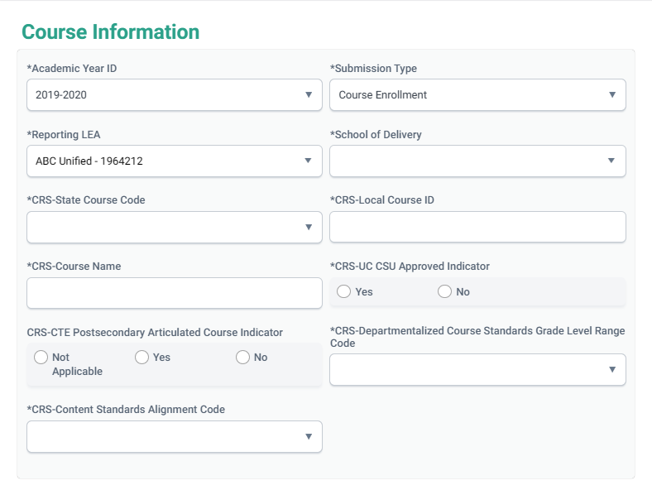
What’s New in CRSE?
CDE will use to determine which standards are being used to develop courses and to highlight the importance of the integration of the ELD Standards.
- CTC will use to determine if teacher has appropriate grade level authorization.
- CDE will use to distinguish course content in varying grade levels
Notes:
Please review the Assignment Monitoring training video to learn more about the data population and business rules -

Slide 19
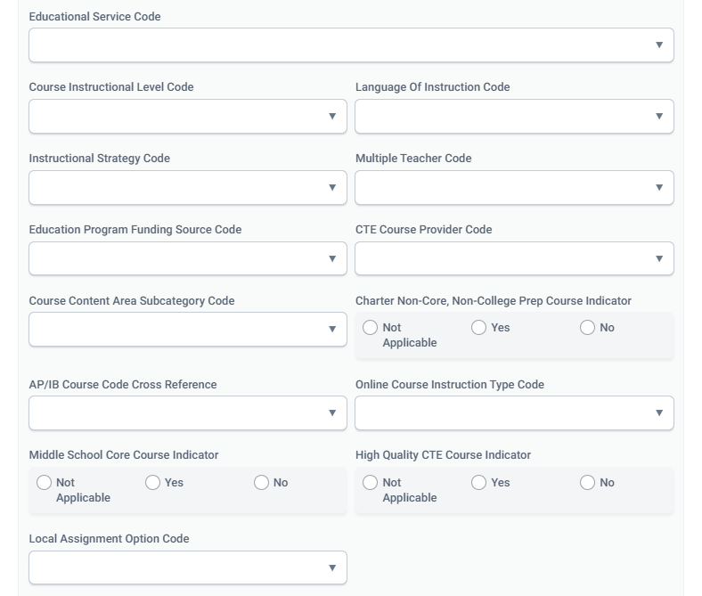
What’s New in CRSE?
- CTC will use to determine whether a subject area authorization is required in certain content areas.
- CDE will use to capture and report more detail about course content.
- CTC will use to determine whether or not a charter school teacher requires a credential and authorizations
5
1
- CTC will use to determine 1) if the course requires an authorized teacher; and 2) if the teacher has the appropriate authorizations for the content.
- CDE will be able to provide more public information on availability of online course content.
Allows LEAs to designate a course as both CTE and AP or IB.
5
6
2
1
6
2
- CTC will use to determine appropriate authorizations in grades 5-8.
3
3
7
Indicates that the course is taught by a credentialed CTE teacher.
Replaces code course content code 154
- CTC will use to determine whether a local assignment option is appropriate for the assignment.
4
7
4

Slide 20
Modified : Course Section Instructional Level Code
Course or Course Section Level? | Data Element Name | Definition | Code Values (examples) | Use?
Course Section | Course Section Instructional Level Code (Existing data element, new values added to code set) | A coded value representing a level at which the content of a specific course is taught that is either above or below a “standard” course instructional level. | 10 Remedial 12 Gifted and Talented 14 Honors - UC Certified 15 Honors - Non-UC Certified 17 Introductory 18 Intermediate 19 Advanced 20 Accelerated 21 Exploratory 22 Bridge 23 College Credit Only 24 Dual Credit | - College credit values used in Career and College Indicator - CDE will use in course enrollment reports in Dataquest to allow for more detailed reporting.
NEW
Notes:
Please note codes 23 and 24 are used in the College Career Readiness Indicator on the CA School Dashboard.

Slide 21
English Learner Services
The Education Service Code is based on the teacher’s credentials and authorizations, but represents the instruction given in the course.
Code | Name | Description
1 | Primary Language Instruction and Designated and Integrated English Language Development (ELD) Instruction | This course section is providing primary language instruction, English Language Development (ELD), and Specially Designed Academic Instruction in English. Primary language instruction is an approach used to teach academic courses in and/or through a primary language other than English.
2 | Designated ELD Instruction Only | This course section is providing only English Language Development (ELD) instruction, through a primary language other than English, which is an academic subject of English language instruction appropriate for the student's identified level of language proficiency.
3 | Integrated ELD Instruction Only | This course section is providing only Specially Designed Academic Instruction in English (SDAIE) services, which is an approach used to teach academic courses to English learner (EL) students in English.
4 | Designated and Integrated ELD Instruction But Not Primary Language Instruction | The course section is providing English Language Development (ELD) instruction and Specially Designed Academic Instruction in English (SDAIE) but NOT Primary Language Instruction.
5 | No English Learner Services | The course is not providing any instructional services designed specifically for English learners. All courses not providing EL services should be marked with this.
6 | Other English Learner Service | The course section is providing some type of instructional service, that, while specifically designed for ELs, is an instructional service that is not narrowly defined in the other English learner services (Primary Language Instruction, English language development, or Specially Designed Academic Instruction in English).
Notes:
This slide reflects the different Education service codes you can select for each course.
NOTE:
For course sections that are taught by more than one teacher, the value in this field should represent all of the services provided If Code 6 – “Other English Learner Services” is provided by one teacher, and any of the other Education Services are provided by the other teacher, the Education Service Code field should be populated with any of the other service combinations (Codes 1, 2, 3, or 4) and NOT Code 6 – “Other English Learner Services.”
Instructional Strategy Code is required if Education Service code is NOT EQUAL to 5 and 6
LEAs may select only one instructional strategy for each course section. If a course section uses more than one instructional strategy, the following hierarchy should be used to determine which one to choose:
Special Education.
Home and Hospital.
Any of the EL Strategies.

Slide 22
English Learner Services Key Elements
CRSE Education service code
SCSE Student Course Enrollment
SELA
EL Record
SPRG Language Instructional Program (LIP)
File | Element(s) | Values and/or Notes
CRSE | Education Service Code | 1,2,3,4,5,6 (Data Guide Section 2.3.4 & 3.1.2)
SELA | ELAS Status | Must have an EL status
SPRG | Language Instructional Program | Required if student ELAS status is EL
SCSE | Course Section | SCSE must have same Course section ID as CRSE record
Notes:
To report EL services for a student, three steps must be completed:
Report student as EL (SELA)
The course record (CRSE) should have an Education Service code populated in the Education service field based on the teacher’s credentials OR report No English services provided.
Submit the SCSE record to associate the student to the course.
ALL Course section records should have an Educational Service Code reported regardless if EL services is provided or not to avoid CERT104
NOTE: For course sections that are taught by more than one teacher, the value in this field should represent all of the services provided in the course section (a combination of the services those teachers provide). If Code 6 – “Other English Learner Services” is provided by one teacher, and any of the other Education Services are provided by the other teacher, the Education Service Code field should be populated with any of the other service combinations (Codes 1, 2, 3, or 4) and NOT Code 6 – “Other English Learner Services.”
Please review the counts on report 2.4 and 2.5 to ensure they are correct.

Slide 23
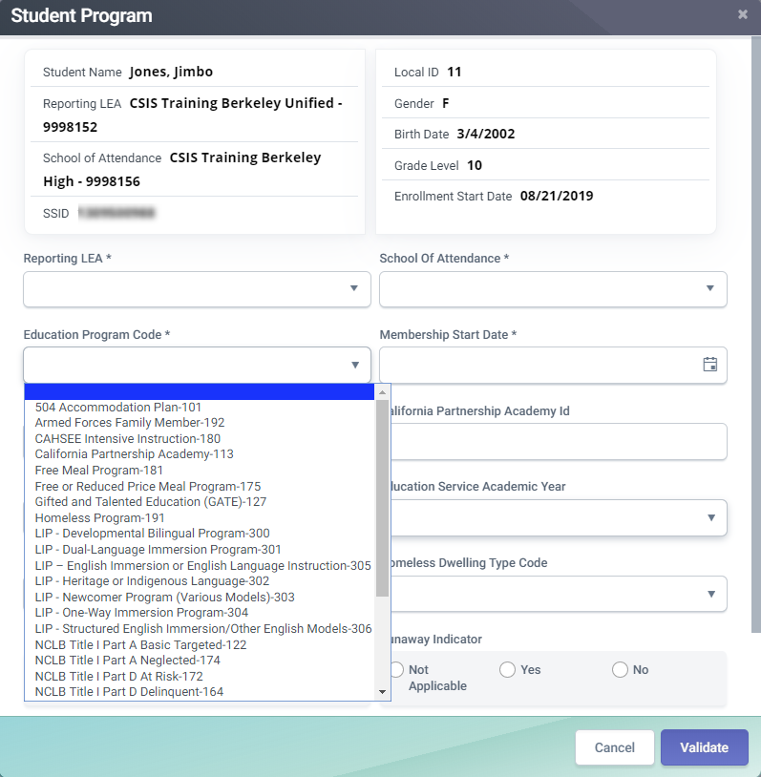
Language Instruction Program
This data element was previously collected from the CRSE as part of the instructional strategy code.
Notes:
The LIP counts are shown on the new report 2.14.

Slide 24
Language Instructional Program (LIP)
Code | Program Name | Description
300 | LIP - Developmental Bilingual Program | A language instructional program (LIP) designed for English learners which provides content instruction delivered in the students’ native language and English.
301 | LIP - Dual-Language Immersion Program | A language instructional program (LIP) designed for English learners and native English speakers, which provides content instruction delivered in the English learners’ native language and English. Program models may include Two-Way Immersion, 50/50 Dual Immersion, 90/10 Dual Immersion, and other similar program models.
302 | LIP - Heritage or Indigenous Language | A language instructional program (LIP) in English and another language for non-English speakers or students with limited literacy skills in their first language. Indigenous language programs support endangered minority languages in which students may have limited receptive and no productive skills. Both programs often serve American Indian students
303 | LIP - Newcomer Program (Various Models) | A language instructional program (LIP) designed for English learners who are new to the country with less than 12 months of schooling in the United States. This program provides instruction in designated and integrated English language development (ELD) based on the state-adopted CA ELD

Slide 25
Language Instructional Program (LIP)
Code | Program Name | Description
304 | LIP - One-Way Immersion Program | A language instructional program in English and another language for non-speakers of the other language, with the goals of language proficiency and academic achievement in English and the other language, and cross-cultural understanding. The portion of the instructional day delivered in each language varies by the type of program.
305 | LIP - Structured English Immersion Program or other predominantly English Language Instructional Models | A language instructional program (LIP) designed for English learners in which nearly all classroom instruction is provided in English with curriculum and a presentation designed for students who are learning English. The goals of this program are language proficiency and academic achievement in English. Students receive instruction in designated and integrated English language development (ELD) based on the state-adopted CA ELD standards
306 | LIP - Transitional Bilingual Program | A language instructional program (LIP) designed for English learners utilizing English and students’ native language for literacy and academic instruction, with the goals of language proficiency and academic achievement in English

Slide 26
2019-20 – Fall -2 Summary of Changes
Functionality | Change
User Interface | New – Guardian 1 First and Last Name to Student Lookup/Request SSID Results View PSTS File Upload via UI (Import) View Submission Details UI for PSTS View Submission Record Details modal for PSTS
 | Modified – Course and Course Section UI to include new fields Course View Submission UI Course Passed Records Details Table Course Data Landing Page Results Table Course Section Details Page UI Gender Codes on the Staff Demo Add/Edit Modal
File Types | New – PSTS file type – used for submitting Perkins E-2 Data Modified – CRSE – file layout changed to include new course attributes
Extracts | New – PSTS ODS & Rejected Records extract Modified - CRSE and CRSC ODS and Rejected Records extracts to include new attributes
Notes:
Here are the different components of CALPADS being affected by the Fall-2 changes.

Slide 27
2019-20 – Fall -2 Document Changes
Functionality | Change
CFS | New – PSTS file layout Modified – Course File Layout Changes (Add/Remove Elements) & Post Move English Learner services from Instructional Strategy Code (CRSE/C) to SPRG
Document | Modified – CFS – El Services from CRSE/C to SPRG, Course File Layout changes Data Guide - Update Guidance on Teacher of Record for Employee Leave
Valid Code Combo | New – CrsGrpSt-ContentSbctgy CrsGrpSt-StndsGrdLvlRange Modified – NonClassSuppAsgn - JobClass Course Group Master Combos Education Prog - Membership Cat NonClassSuppAsgn - Content Area
Help Resources | Modified – User manual and reference documents updated to include new Fall-2 related content
Notes:
Here are the document changes as a result of the changes for Fall-2.

Slide 28
Postsecondary Status
Notes:
Let’s talk a little bit about the Postsecondary Status now.
You can find more information about the PSTS file submission and business rules in Flash # 164 - https://www.cde.ca.gov/ds/sp/cl/calpadsupdflash164.asp

Slide 29
Postsecondary (PSTS)
The Postsecondary file format is used to submit employment and educational status six months after exiting secondary education; and after completing secondary education in the prior academic year. For fall 2 the file will be used to report:
Career technical education (CTE) concentrators and completers
Students participating in the California Partnership Academy (CPA)Program (Suspended for 2019-20)
Notes:
Students Reported for PSTS
Fall 2: Submit only Postsecondary Status (PSTS) records for students who exited secondary education in the prior academic year that were identified as:
Career technical education concentrators and completers; and
Students who participated in the CA Partnership Academic Program (suspended for AY 2019-20)

Slide 30
PSTS Key Data for Fall 2
The Postsecondary (PSTS) file contains the following information:
Education Program Participation Type Code
A code value representing the education program that the student last participated in prior to completing grade 12.
Postsecondary Status Code
A coded value representing the student's postsecondary status after exiting secondary education.
CTE Related Program or Employment Indicator
An indication of whether the postsecondary education, employment, or training is related to the Career Technical Education (CTE) pathway that the student participated in prior to completing grade 12.
Notes:
The PSTS is a small file used in fall 2 and EOY 4. There are only 13 data elements, some of which only pertain to students with disabilities for EOY 4 reporting. The data used in fall 2 are:
Education Program Participation Type Code
Postsecondary Status Code
CTE Related Program or Employment Indicator

Slide 31
2019-20 – Fall -2 Validation Changes
Functionality | Change
New Validations | CRSE0456 (F) - Online Course Instruction Type Code should not be populated
 | CRSE0457 (F) - Missing Online Course Instruction Type Code
 | CRSE0458 (F) - Missing Middle School Core Course Indicator
 | CRSE0459 (F) - Invalid State Course Code for AP/IB Course Code Cross Reference
 | CRSE0460 (F) - Content Standards Alignment Code must equal 3 for this CRS – Departmentalized Course Standards Grade Level Range Code
 | CRSE0461 (F) - Content Standards Alignment Code must not equal 3 for this CRS – Departmentalized Course Standards Grade Level Range Code
 | CRSE0462 (F) - Course Content Area Subcategory Code is required for this State Course Code
 | CRSE0463 (F) - Course Content Area Subcategory Code must be blank for this State Course Code
 | CRSE0464 (F) - High Quality CTE Course Indicator not valid for this Course Section
 | CRSE0465 (F) - High Quality CTE Course Indicator is required for this Course Section
 | CRSE0466 (F) - Missing Charter Non-Core, Non-College Prep Course Indicator
Notes:
Here we will discuss the validation changes for this year and their impact.

Slide 32
2019-20 – Fall -2 Validation Changes
Functionality | Change
Validations | New – CRSE0467 (F) - Invalid Course Group State and Content Course Area Subcategory Combination
 | New – CRSE0468 (F) - Invalid Course Group State and CRS – Departmentalized Course Standards Grade Level Range Code Combination
 | New – CRSE0469 (F) - AP/IB Course Code Cross Reference populated for non-AP/IB course
 | Modified – CRSE0131 (F) - Missing Language of Instruction Code
 | Modified – CRSE0132 (F) - Invalid Language of Instruction Code
 | Modified – CRSE0231 (F) - Mismatch of Course (CRS) Attributes
 | Modified – CRSE0274(F) - More than one Education Service Code submitted for the same Course Section
 | Modified – CRSE0462 & 463 (F) - Updated to Remove Course Code 9002 and Add Course Codes 9156 & 9157
 | Disabled – CRSE0223 (F) - Missing English Learner Instructional Strategy Code
 | Disabled – CRSE0224 (F) - Missing Education Service Code
 | Disabled – CRSE0298 (F) - Course Content Code 154 (High Quality CTE) not valid for this Course
Notes:
Here we will discuss the validation changes for this year and their impact.

Slide 33
2019-20 – Fall -2 Validation Changes
Functionality | Change
Validations | New – SENR0470 (F) - Restricts the Use of Student Met all UC CSU Requirements Indicator for Graduates Only
 | New – SENR0454 (F) - Postsecondary/Transition Status Indicator for previous SENR records
 | New – SASS0473 (F) - Duplicate Non Classroom Based Job Assignment Code
 | New – SASS0474 (F) - Non Classroom Based Job Assignment Codes 1-7 must be populated in sequential order
 | New – SDIS0455 (F) - Prevents 2019-20 SDIS data from being added to CALPADS
 | Modified – SENR0439 (F) - Update for Postsecondary/Transition Status Indicator
 | Modified – SENR0026 (F) - (Invalid Birth Date or Grade for CHPSE Completion) Trigger and Severity from W to F
Certifications | New – CERT146 (F) - Language Instruction Program record missing for English Learner-Warning
 | Modified – CERT048 (F) - (Missing non-classroom based assignment or course section record) to Trigger at School of Assignment
 | Disabled – CERT090 (F) - EL, RFEP, or IFEP student reported with a Primary Language of English or Sign Language
🖌 NOTE: Review the Error List (v11.x) document for error details and resolution
Notes:
Here we will discuss the validation changes for this year and their impact.

Slide 34
2019-20 – Fall -2 Reports Changes
Functionality | Change
New Reports | 2.14 - Language Instruction Program – Count 17.1 - Postsecondary Survey Outcome for CTE/CPA Students – Count 17.2 - Postsecondary Survey Outcome for CTE/CPA Students – Student List
Reports Modified | Aggregate Reports 2.4 - English Learner Education Services - Student Count Unduplicated & 2.5 - Unduplicated Count of Teachers Providing EL Services 4 Columns titles changed to reflect new EL service code names 3.6 - Course Section Enrollment - Count by Content Area 1 New Filter - Course Content Area Subcategory 2 New Columns
 | Additional Supporting Reports 3.1, 3.2, 3.3, 3.8 1 New Filter - Course Content Area Subcategory 1 New Columns - Course Content Area Subcategory 3.7 - Course Section Enrollment - Count and Details 2 New Filters - Course Content Area Subcategory 9 New Columns – Course Attributes 4.3 - Staff Teaching Assignments – Detail 9 New Filters 6 New Columns – Course Attributes 4.4 - Staff Profile – List 1 New Filter - Non-Classroom Based Job Assignment
 | All Fall 2 Snapshot Reports: "Not Certified" Watermark removed when Revision Status = LEA Approved
Notes:
Here we will discuss the reports changes for this year and their impact.

Slide 35
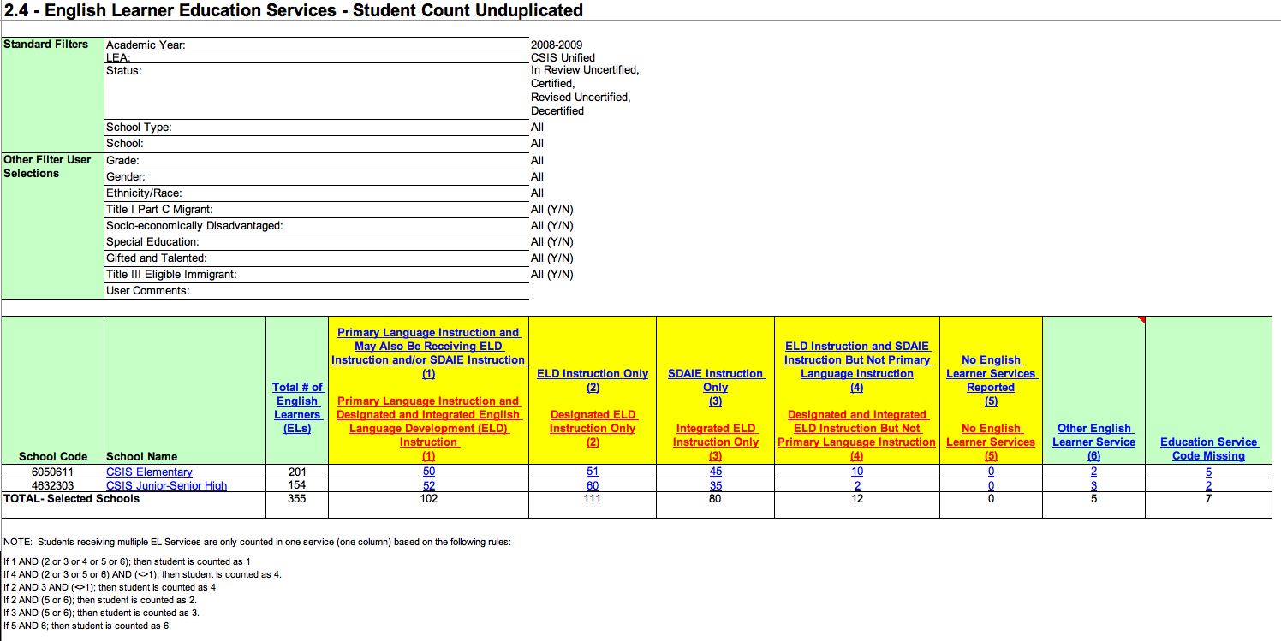
2019-20 – Fall -2 Reports Changes
Notes:
Here we will discuss the reports changes for this year and their impact.

Slide 36
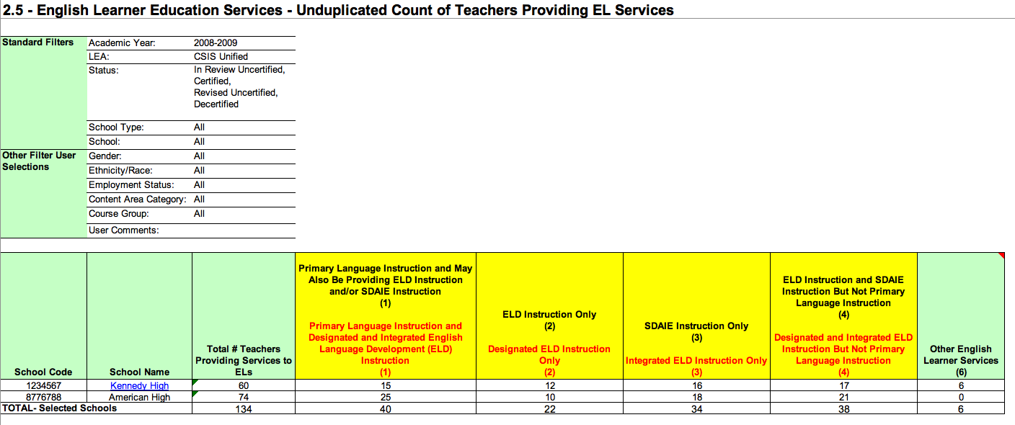
2019-20 – Fall -2 Reports Changes
Notes:
Here we will discuss the reports changes for this year and their impact.

Slide 37
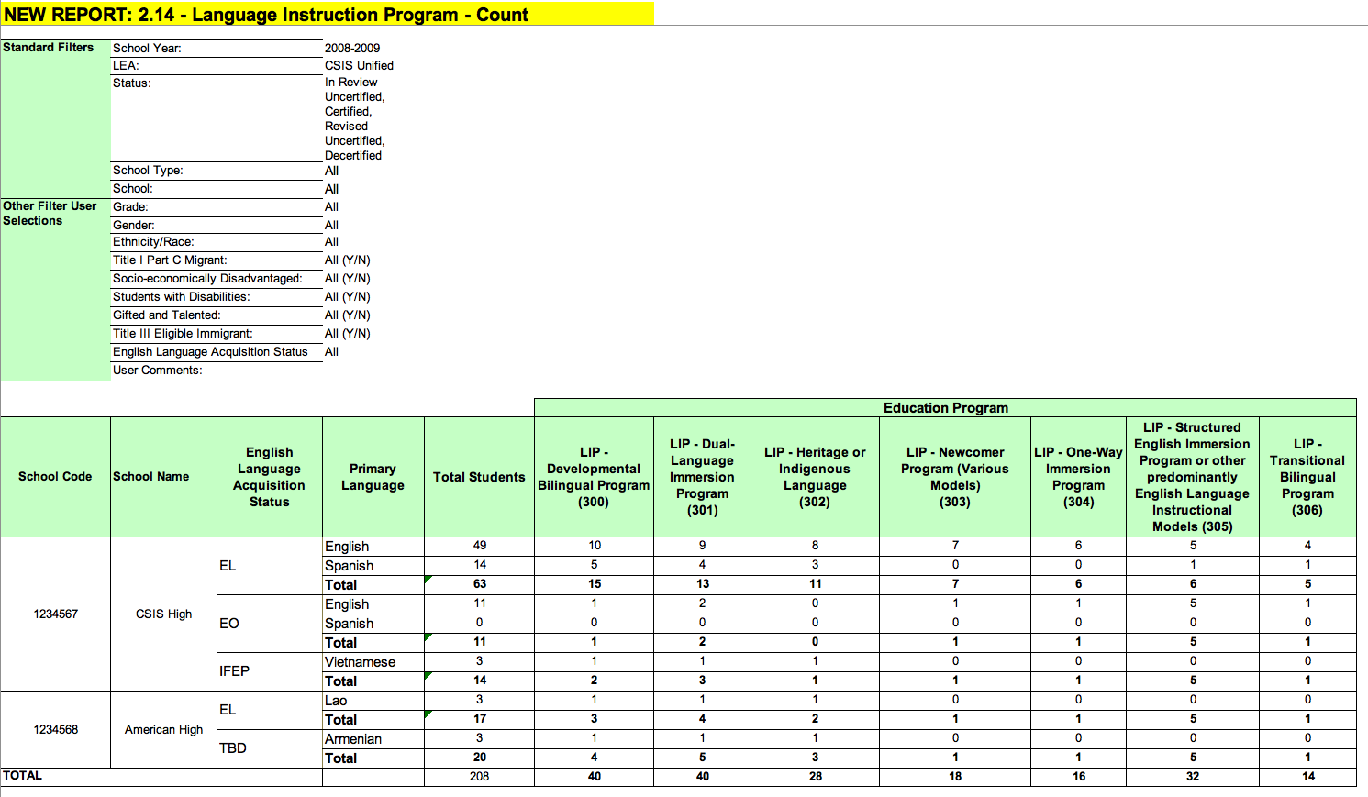
2019-20 – Fall -2 Reports Changes
Notes:
Here we will discuss the reports changes for this year and their impact.

Slide 38
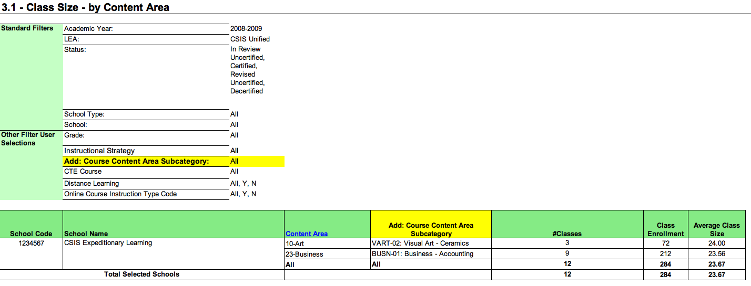
2019-20 – Fall -2 Reports Changes
Notes:
Here we will discuss the reports changes for this year and their impact.

Slide 39
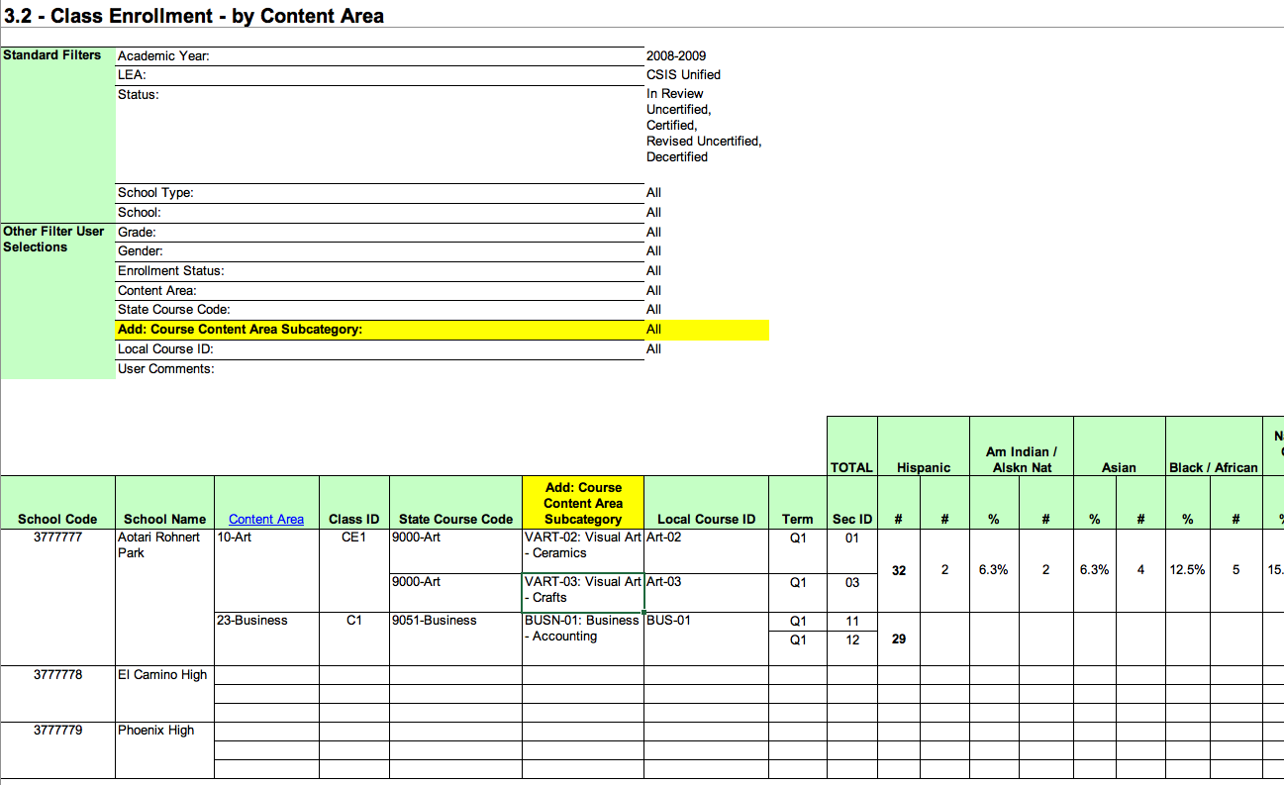
2019-20 – Fall -2 Reports Changes
Notes:
Here we will discuss the reports changes for this year and their impact.

Slide 40
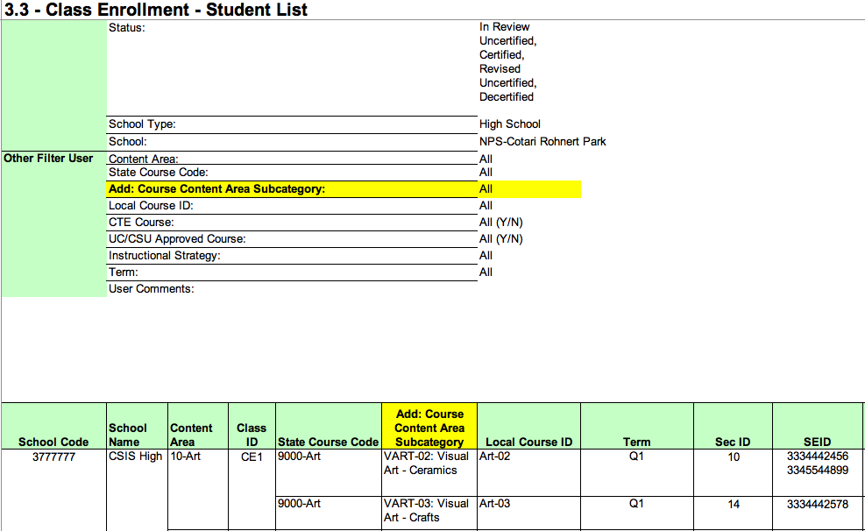
2019-20 – Fall -2 Reports Changes
Notes:
Here we will discuss the reports changes for this year and their impact.

Slide 41
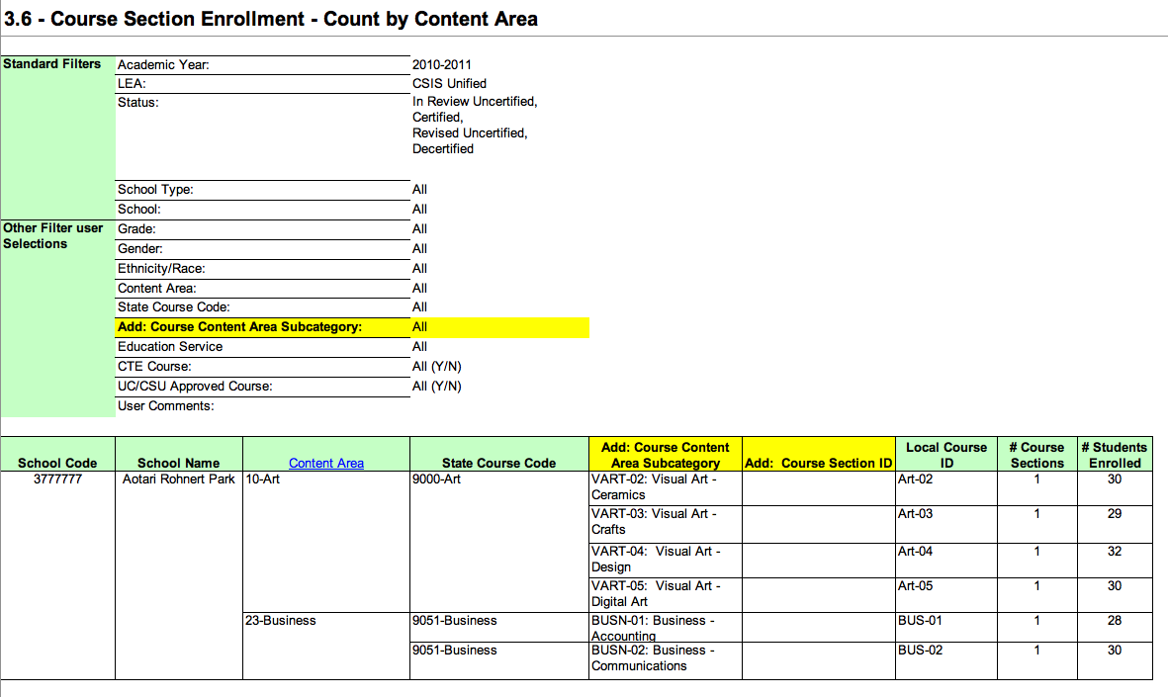
2019-20 – Fall -2 Reports Changes
Notes:
Here we will discuss the reports changes for this year and their impact.

Slide 42
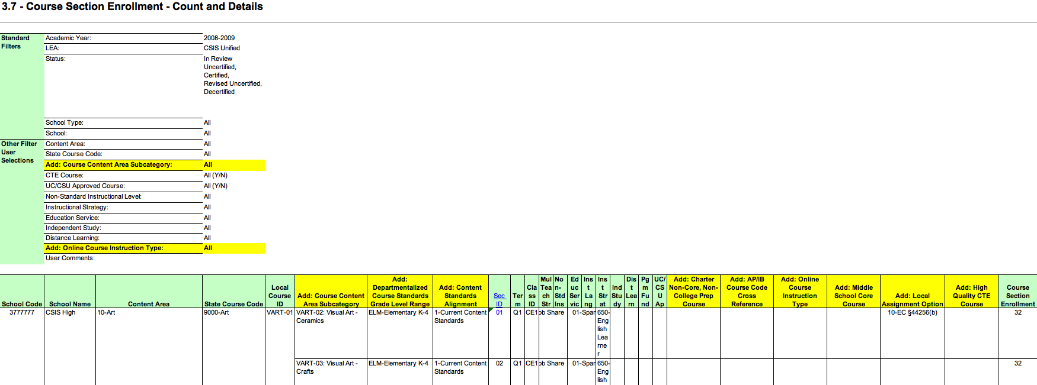
2019-20 – Fall -2 Reports Changes
Notes:
Here we will discuss the reports changes for this year and their impact.

Slide 43
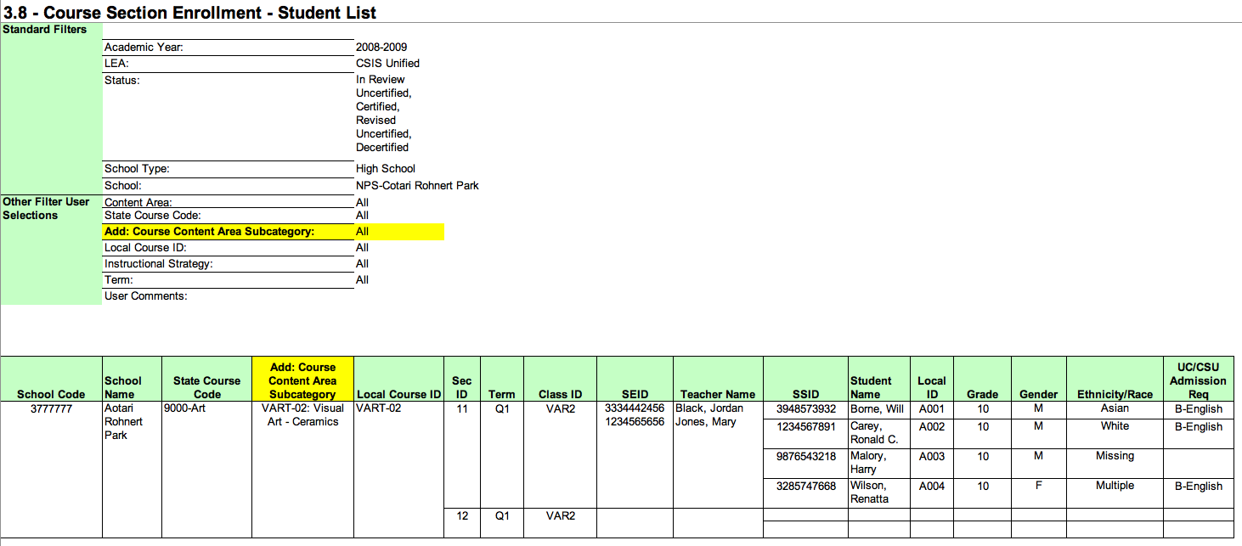
2019-20 – Fall -2 Reports Changes
Notes:
Here we will discuss the reports changes for this year and their impact.

Slide 44
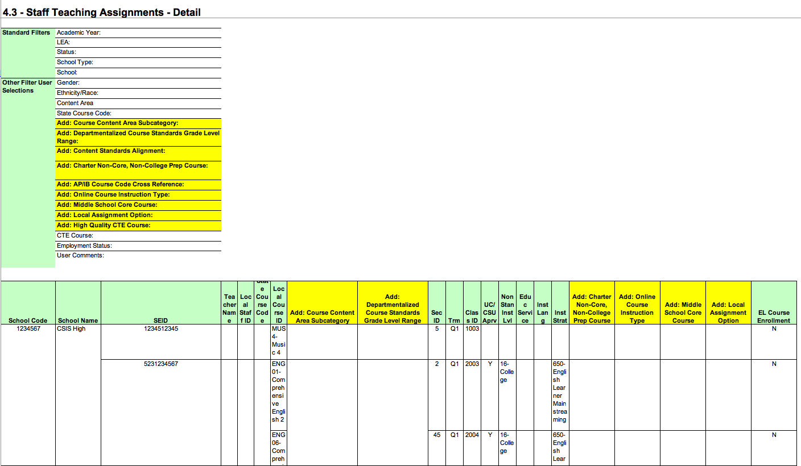
2019-20 – Fall -2 Reports Changes
Notes:
Here we will discuss the reports changes for this year and their impact.

Slide 45
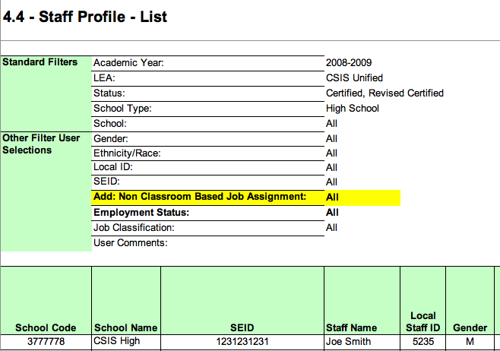
2019-20 – Fall -2 Reports Changes
Notes:
Here we will discuss the reports changes for this year and their impact.

Slide 46
Certification Trend Warnings Disabled
Significant changes in school
No data
 | School | LEA
Administrator FTE (CERT026) | X
English Learners (CERT035) | X
Number of Teachers Providing EL Svcs (CERT036) | X
Percentage Change in Number of ELs Receiving Education Services (CERT065) | X
Pupil Services FTE (CERT080) | X
Teachers FTE (CERT025) | X
Administrator Staff Assignment Missing (CERT050)
Conflicting numbers
Not Enough Course Sections to = FTE (CERT070)
Questionable proportions
Invalid records
Enrollment Count for a Course Section Exceeds Expectations (CERT062)
Staff FTE % (CERT105)
🖌 NOTE: LEAs will need to do their own analysis against prior year submissions
Notes:
Normally it is also important to review your certification warnings in addition to the certification errors.
The aggregates which were checked last year are listed here for your reference. It is recommended that your LEA manually review the related counts and records to ensure they do not have these discrepancies. For example, your LEA should compare it’s previous year enrollment counts for a course section to the current year counts to make sure any discrepancies are intended.
You can look up these certification errors in the CP Error List document under the “Fall 2 Certification” tab. Note: You must enable the filter under the “Updates” column to see these errors.

Slide 47
Common Problems
Discuss Fall-2 Common Problems
Notes:
Let’s review some of the common problems…

Slide 48
Fall 2 Common Problems
SASS0118
Staff Job Classification FTE Percentage Less than 1.0 or Employee on Leave Percentage Greater Than 0
Solution
Verify that Staff Job Classification FTE Percentage for a staff member who is not on leave is greater than or equal to 1.0 or employee on leave percentage is 0.

Slide 49
Fall 2 Common Problems
CERT049
Error occurs when a staff assignment is reported for a SEID for which there is no staff demographic record reported (Fatal)
Solution
Post staff demographic record for the teacher
Verify the staff hire date is on or before information day
Notes:
This slide is marked as hidden to be used as a reference outside of the training session.

Slide 50
Fall 2 Common Problems
CERT054
Error occurs when a course section is reported for a teacher (SEID) for which there is no staff demographic record reported (Fatal)
Solution
Post staff demographic record for the staff member (SEID)
Verify the staff hire date is on or before information day
Notes:
This slide is marked as hidden to be used as a reference outside of the training session.

Slide 51
Fall 2 Common Problems
CERT047
Teaching Staff Assignment Missing A course section includes a SEID for which there is no valid teaching assignment information.
Solution
The teaching assignment must be reported at the site the course is being taught.
Notes:
This slide is marked as hidden to be used as a reference outside of the training session.
The CERT047 is detected on a course reported for a teacher, at a specific site and teacher doesn’t have an assignment record report for that site. If the teacher is teacher at a site, there must be an assignment record.

Slide 52
Fall 2 Common Problems
CERT048
Missing non-classroom based assignment or course section record
Solution
All certificated staff must either have a course record or have a non-classroom based assignment
Notes:
This slide is marked as hidden to be used as a reference outside of the training session.
The CERT048: If you report staff for the current academic year, they need an assignment record: either non-classroom based, teaching a course, or employment end date

Slide 53
Fall 2 Common Problems
CERT082
Error occurs when only one course section is reported with a multiple teacher code
Solution
Post another course section record with the other teacher’s SEID and the same Class ID
Notes:
This slide is marked as hidden to be used as a reference outside of the training session.

Slide 54
Fall 2 Common Problems
CERT083
Error occurs when a student course section is reported and the course section does not exist in the CALPADS
Solution
Verify that the student course section is correct (i.e. Local Course ID, Course Section ID, & Academic Term)
Post the course section record
Notes:
This slide is marked as hidden to be used as a reference outside of the training session.

Slide 55
Fall 2 Common Problems
CERT075
Error occurs when the teacher’s staff employment start date or end date does not fall within the reporting period, 7/1/19 - 11/4/19
or
Record effective start date not between 7/1/19 and 11/4/19 (Census Day plus 30 calendar days)
Solution
Verify that the employment dates are correct
If yes, delete the record as SEID should not be reported
If no, submit the correct employment dates
Notes:
This slide is marked as hidden to be used as a reference outside of the training session.

Slide 56
Fall 2 Common Problems
CERT076
Error occurs when the admin or support staff’s staff employment start date or end date does not fall on census day
or
Record effective start date not between 7/1/16 and 10/5/16
Solution
Verify that the employment dates are correct.
If yes, delete the record as SEID should not be reported
If no, submit the correct employment dates
If staff leaves district, provide Employment End Date and not the Effective End Date.
Notes:
This slide is marked as hidden to be used as a reference outside of the training session.

Slide 57
Fall 2 Common Problems
CERT077
Error occurs when no student course section records are reported for a student whose enrollment status on Census Day is Primarily Enrollment (10)*
Solution
Verify the student’s enrollment status on Census Day
If correct, submit the student course section records (SCSE) for the student
If not correct, submit updated student enrollment records (SENR)
Notes:
This slide is marked as hidden to be used as a reference outside of the training session.

Slide 58
Fall 2 Common Problems
CERT084
Error occurs when no staff assignment data was submitted for staff with staff demographics data
Solution
Verify that the staff demographics are correct
If yes, submit staff assignment record(s)
If no, delete the staff demographic record
Notes:
This slide is marked as hidden to be used as a reference outside of the training session.

Slide 59
Fall 2 Common Problems
Staff on Leave Requires
SDEM record for active employees
Employment End Date is not populated
SASS record required with the Non-Classroom Assignment 6018
FTE must be reported as 0.0%
SASS0118 will be detected if FTE is > 0.0%
Staff No Longer Employed on Census Day
Employment End Date is reported not the Effective End Date
Notes:
Review the slide in detail…

Slide 60
Fall 2 Common Problems
Report a substitute teacher…
When the substitute teacher teaches the class on Census day for a course with a permanent teacher on record
When Subs are employed on Census day but not subbing on that day.
Report with SASS Non-Classroom Job Assignment code of 6014
Teaching a class that has no teacher on record on Census day and pending the hiring of a permanent teacher.
Report the substitute teacher’s SEID to the course. You may also report the teacher with Non-Classroom Job Assignment code of 6014 (optional)
Notes:
If the teacher is on leave on census day and beyond, report that permanent teacher.
Non-classroom Based Job Assignment Code (Day to Day substitute teacher - permanent emp. - 6014) should be used for subs that are either:
subbing on Census day for a course with a permanent teacher; or
subs who are employed on Census day but not subbing on that day.
If a sub is in the classroom for a course with no permanent teacher, they get reported in the course record. However, there is nothing preventing both a 6014 and a course assignment being reported for these individuals.

Slide 61
Fall 2 Common Problems
Communicate & Collaborate Early
Report EL Services for all courses with EL students
Coordinate EARLY to identify EL courses and services provided
State Course Code Assignment
Request signoff of current assignments
Report Verification
Request signoff of certification and supporting reports
Competing Priorities
Collect data throughout the year
Perform regular enrollment updates
Check ODS reports periodically
Notes:
Review the slide in detail…

Slide 62
Wrap Up
Key Points, Resources and Support

Slide 63
Summary
Review the Fall-2 Changes again and ensure you share with others in your LEA.
Assignment Monitoring introduces many new CRSE/Course Attribute & Code Changes
Perkins E2 is reported via PSTS file Type (submitted in Fall 2 and EOY 4) – Flash #164
English Learner Services moved from Instructional Strategy Code (CRSE/C) to Language Instructional Programs (SPRG)
There are many report changes and 3 new reports for Fall-2
Fall-2 Certification is a one step approval process.
Communicate, Collaborate and Coordinate!!
Some key points to remember

Slide 64
Resources
Here are some important resources related to Fall-2 reporting.
https://learn.fcmat.org/
https://www.youtube.com/c/CSISCALPADSTrainingChannel
https://documentation.calpads.org/Support/References
https://csis.fcmat.org/resources/

Slide 65
Support
http://www2.cde.ca.gov/calpadshelp/default.aspx
Web
calpads-support@cde.ca.gov
Email
916-325-9210
Phone
http://www.cde.ca.gov/ds/sp/cl/listservs.asp#listservs
You can get help through these channels.
Listserv

Slide 66
Feedback
I have a question…
“
”
Please complete survey…
https://bit.ly/2MXsECg
“
”
Notes:
Please take the time to complete our training survey. Your responses assist in improving our trainings.
We review these surveys on a regular basis—in fact due to LEAs’ suggestions we have changed our survey, have included more visual aids, and demonstrations in our trainings.
If you experience any technical difficulty with accessing the survey, please try the alternative long URL:
Long URL: https://forms.office.com/Pages/ResponsePage.aspx?id=k1b3XxqV6E2E3dWxsESwNX2FYi3dRZNNt8LpvkF_wmhUNVRLOVBDVkoySE01UTJSRk42VTlaUUFIQi4u
Short URL: https://bit.ly/2MXsECg
Thank you for providing us the opportunity to evaluate our trainings.

Slide 67
Thank You
CSIS Training Team
916-325-9200
csistraining@fcmat.org
https://csis.fcmat.org/

